Slide 1
Safe Ministry with Vulnerable People
Refresher course

Slide 2
Introduction
Breaks
Amenities
Hazards
Learning styles
2

Slide 3
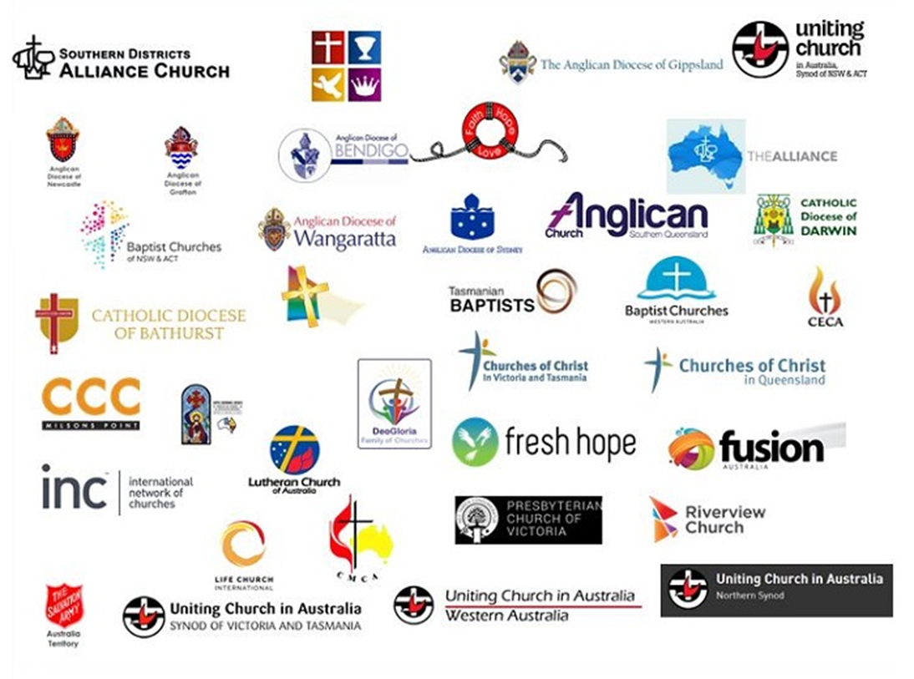
NCCA Safe Church Program members
3

Slide 4
Importance of Safe Ministry training
Vulnerable persons need protection
We need to understand how to best protect them
We need to keep up-to-date and refresh our thinking and practice
4

Slide 5
Overview of Safe Ministry workshop
Safe Ministry training is relevant for anyone working with vulnerable people in our churches.
Topics covered include:
Foundations of Safe Ministry
Appropriate Leadership
Best Practices
Safe Environments
5

Slide 6
Guidelines for this workshop
Share your knowledge and skills
Stay on track and keep to time
Respect one another’s right to a different opinion
Respect any personal stories that may be shared as confidential
Understand this is awareness training
Pastoral Support is available if you need it
6

Slide 7
Support documentation
Faithfulness in Service (2017)
Safe Ministry Blueprint documents
Safe Ministry to Children Ordinance 2020
Child Safe Standards
Helpful phone numbers and websites page
Additional resources at https://safeministry.training/resources/
7

Slide 8
Safe Ministry with Vulnerable People
Refresher course
8

Slide 9
1. FOUNDATIONS OF SAFE MINISTRY
Appropriate Leadership
Best Practices
Safe Environment
9

Slide 10
Child Safe Standards
Appropriate Leadership
(Standards 1-5)
Best Practices
(Standards 6-7)
Safe Environment
(Standards 8-10)
10

Slide 11
2. APPROPRIATE LEADERSHIP
Appropriate Leadership
Best Practices
Safe Environment
11

Slide 12
Power in leadership
Positional power
The authority and training associated with [clergy and church workers] roles means that they have power in pastoral relationships which is always to be exercised in the service of others.
Faithfulness in Service, 4.2 (2017)
Bullying
If another person indicates by their words or actions that they feel bullied or harassed by you, review your conduct.
Faithfulness in Service, 6.17 (2017)
12

Slide 13
Power in leadership
Empowering vulnerable people
[children] want to be involved in identifying and dealing with safety issues and believe that, in partnership with adults and institutions, issues such as child sexual abuse can be better dealt with.
Protective participation supports the empowerment of children and young people and encourages them to be meaningfully engaged in their own protection … [by] working with [leaders] to respond to their safety needs.
13

Slide 14
Boundaries in leadership
A suitable leader for ministry must be a boundary respecter.
Faithfulness in Service 2017
Safe Ministry Blueprint documents
14

Slide 15
Leader selection
15

Slide 16
Leader selection
Recruiting and appointing leaders involves:
Job description
Application for ministry positions
Relevant screening procedures
Expectation of leaders (code of conduct)
Support for leaders
16

Slide 17
Safe Ministry with Vulnerable People
BREAK
Please sign the Pledge
17

Slide 18
3. BEST PRACTICES
Appropriate Leadership
Best Practices
Safe Environment
18

Slide 19
Domestic abuse
Domestic abuse can occur in all communities, including churches.
Responding to Domestic Abuse: Policy and Good Practice Guidelines, 1.4.2
The dominating factors in domestic abuse relationships are
coercion
control
intimidation
fear
19

Slide 20
Recognising abuse
Indicators of abuse
A one-off indicator is rarely sufficient to establish abuse or risk of significant harm.
Disclosure of abuse
Recognise the barriers that a victim must overcome before they disclose abuse.
20

Slide 21
Receiving a disclosure
Listen
Reassure
Think
Report
21

Slide 22
Who to inform
Head ministry leader/Principal
Concerns for a child’s welfare or
suspicions regarding leader conduct
Child Protection Helpline
Concerns regarding the welfare of a child (mandatory reporting)
Police
Report criminal conduct or
receive emergency assistance
Anglican Abuse Report Line/ PSU
Allegations of abuse or misconduct by Sydney Anglican church worker
22

Slide 23
Reporting suspected child abuse
General suspicions | Head ministry leader (church) Principal (school)
Current risk of significant harm | Child Protection Helpline (DCJ) Police Safe Ministry Team (PSU)
Relevant criminal offences | Police Safe Ministry Team (PSU)
Child abuse by a church worker | Senior Minister/employer Anglican Abuse Report Line Police
17

Slide 24
Reporting concerns regarding adults
Contact the police when:
A person is in danger
A person threatens to harm them self or others
A criminal offence has been committed
Contact the senior minister and Safe Ministry Team (PSU) when there is inappropriate conduct or abuse by a church worker.
24

Slide 25
Ongoing care and support
Survivors
Pastoral Care and Assistance Scheme
Taking Abuse and Other Misconduct Seriously
Taking Bullying and Other Misconduct Seriously
Others
Debrief with an appropriately skilled person
Parish Support Team
25

Slide 26
4. SAFE ENVIRONMENT
Appropriate Leadership
Best Practices
Safe Environment
26

Slide 27
Risk Management
Think
What could go wrong?
Evaluate the risk - low, moderate or high risk
Do
What control measures will be used?
Who is responsible?
27

Slide 28
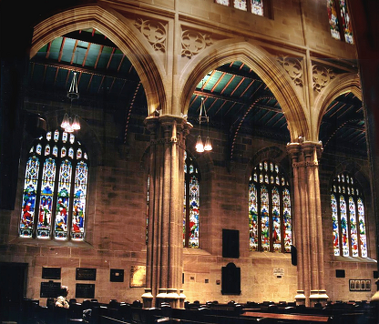
Policies and practices for a safe environment
Emotional & Social
Physical
Online
28

Slide 29
5. CASE STUDY
What are the potential concerns?
How could they be prevented or managed at each stage?
29

Slide 30
Safe Ministry Checklist
Safe Ministry policy & Safe Ministry Representative Child Safe Standard 1, 10
Appropriate Leadership Child Safe Standards 2 - 6
Best Practices Child Safe Standards 6 - 7
Safe Environment Child Safe Standards 8 - 10
30

Slide 31
Feedback
Please complete an online evaluation form at
https://safeministry.training/feedback/
31

Slide 32
Safe Ministry with Vulnerable People
Refresher course

